Slide 1
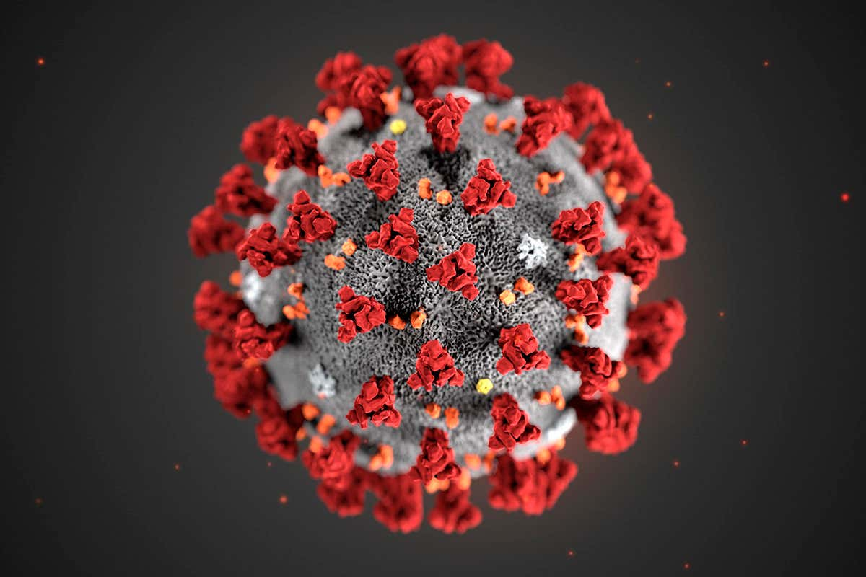
COVID-19 Clinical Update
I-TECH Videoconference November 9, 2020
Matthew Golden, MD, MPH
Professor of Medicine, University of Washington
Director, PHSKC HIV/STD Program
Director, UW Center for AIDS and STD
Last Updated: November 9, 2020

Slide 2
Overview
Epidemiology
Contact tracing, isolation and quarantine
Treatment & prevention

Slide 3
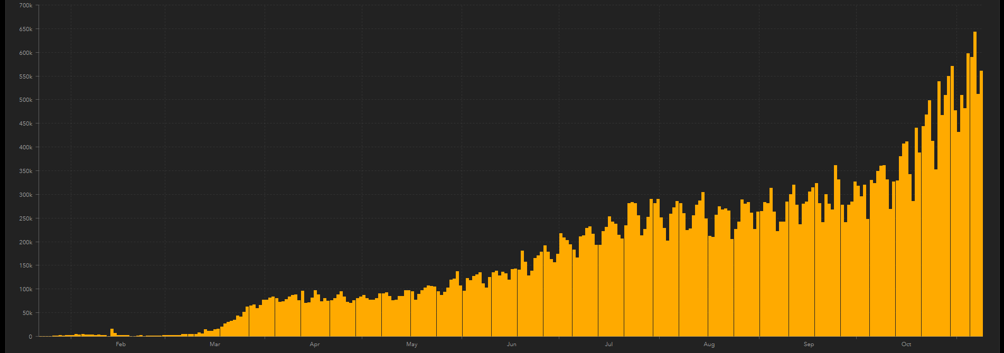
Cumulative Global COVID-19 Diagnoses
700K
685,295
600K
560,969
500K
400K
300K
200K
100K

Slide 4
Global Incidence COVID-19 11/4//20-11/8/20

Slide 5
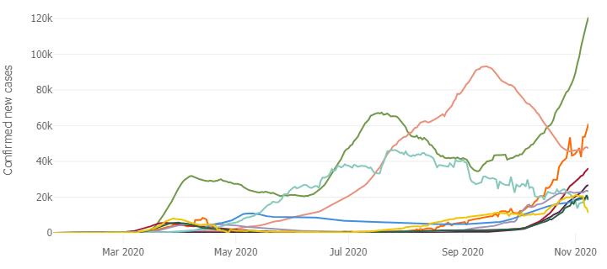
Dailey Confirmed Cases (7-Day Moving Average) in 10 Most Affected Countries

Slide 6
Dailey Confirmed Cases
South Africa
Kenya

Slide 7
Contact Tracing: Singapore
Background – Need for better data on which contacts are at risk for COVID-1
Design – Retrospective cohort study
Population – 770 contact of 1114 PCR+ cases in Singapore Jan-Apr 2020
Household
Non-household – 30 min within 2m
Intervention: All contacts quarantined with 3x per day symptom check and testing of symptomatics
Subset later had serological testing
Outcome: PCR positivity, risk factors for positivity, missed infections by not testing asymptomatic contacts
 | PCR+* | Estimated Infection
Household | 5.9% | 11%
Work | 1.3% | 5%
Social | 1.3% | 4%
* Only symptomatics tested
Ng, OT Lancet ID 2020

Slide 8
Contact Tracing: Singapore
Household Contacts
Shared bedroom but did not use the same toilet | 5.4 (1.8-15.8)
Shared bedroom and used same toilet | 5.0 (1.85-13.8)
Spoke COVID-19 case <30 min | 3.9 (2.1-7.3)
Spoke COVID-19 case >30 | 7.9 (3.9-16.0)
Study emphasize need to test asymptomatic contacts
Households – Speaking and shared rooms (not bathrooms)
Non-Households – Events with >1 case, vehicles and speaking
No association with age, sex, number COVID-19 contacts, indirect contact (objects), sharing meals
Non-household Contacts (work and social)
Contact >1 COVID-19 case | 3.9 (2.1-7.4)
Took same vehicle with COVID-19 case | 3.1 (1.6-6.1)
Spoke COVID-19 case <30 min | 2.5 (1.2-5.4)
Spoke COVID-19 case >30 | 2.67 (1.2-5.9)
No association with age, sex, indirect contact (objects), sharing meals, sharing toilet, OR MASK USE
Ng, OT Lancet ID 2020

Slide 9
Contact Tracing: TN & WI USA
Results
102/191 (53%) household contacts PCR+
54 (53%) contacts PCR+ at enrollment
35% of contacts (47% infected contacts) had a subsequent PCR that was positive
67% of infected contacts developed symptoms - <50% infected had symptoms initially
Design – Prospective cohort study
Population – 101 households and 191 household contacts in Nashville, TN and Marshfield, WI
Intervention: Symptom diary and daily nasal swabs and saliva (subset) for 14 days (7 days presented)
Outcome: PCR positivity
Grijalva CG. MMWR 2020

Slide 10
Contact Tracing in San Francisco
Results
Design – Program evaluation
Population – 791 persons interviewed for CT (focus only on named contacts not previously diagnosed
Outcome: PCR positivity
84%
Case-finding index = 0.15
38%
10%
Only 9 non-household contact identified!
Sachdev DD. JAMA Int Med 2020

Slide 11
Contact Tracing: Can This Work?
COVID-19 positivity in household members is often high
Identifying infected people in a household helps people define I&Q needs
Means to identify people who need medical and social services
Could prevent transmission if support effectively promotes adherence with isolation and quarantine
Timing of contact tracing from infection to contact tracing interview, King County, WA

Slide 12
Contact Tracing: Can This Work?
Beyond household adherence to I&Q, prevention benefit depends on finding infectious people who are not in isolation and quarantine
Focus needs to be on nonhousehold contacts
Emphasize venues and events among nonhousehold contacts
Over 4 weeks, 1276 cases report attending workplaces or social events
How prioritize?
Change contact period – Backward contract tracing (upstream)
Some people transmit to many people
Going backward (upstream) identifies those high transmitting people/events
Support in mathematical model (Endo A. Wellcome Open Research 2020)
Do we need a longer contact period? - Change from 2 days prior to onset of symptoms vs. 14 days
No data – very dependent on timeliness

Slide 13
Optimal Quarantine & Testing Strategy
8.3 day incubation
Background: Current recommendations for contacts to quarantine for 14 days following their last exposure are onerous
Study question: How can we best avert transmission AND minimize quarantine
Design – Mathematical model to estimate post-quarantine transmission (PQT) with different testing approaches
Test entry into quarantine
Test exit quarantine
Test both entry & exit
Testing at exit is better than at entry, particularly if incubation period is longer
Testing at entry and exit could potentially cut 7 days from the quarantine period
Testing at entry helps, but mostly only with shorter incubation period
5.2 day incubation
Wells CR mdRxiv2020

Slide 14
Persistence of Neutralizing Antibody
Background: Prior studies have shown loss of antibody positivity over time, particularly among asymptomatic persons – implications vaccines
Design – Cross sectional & prospective cohort study
Spike protein (not nucleoprotein)
Population – 30,082 COVID-19 antibody positive persons tested in Mt Sinai hospital, NYC
Outcome: Antibody titter, neutralization, persistence
Good news – Neutralizing antibody response persists
Other studies suggest that this may not be the case (Anna F. medRxiv, Seow J Natrure Micro 2020)
Correlates of immunity remain uncertain
Emphasizes need for clinical studies
Only 3/121 (2.5%) became antibody negative over mean 148 days
Source: Wajnberg A. Science 2020

Slide 15
Vaccine News!
43,538 people enrolled
38,955 have received 2nd dose
“No serious safety concerns”
Data based on interim analysis of first 94 infections
Goal 164 cases
Anticipated submission to US FDA 3rd week of November
https://www.pfizer.com/news/press-release/press-release-detail/pfizer-and-biontech-announce-vaccine-candidate-against

Slide 16
Remdesivir – Last Month
Background
Small Chinese study – no benefit
ACTT-1 – Preliminary data already published -> FDA approval
JAMA study showed benefit in patients not on 02
This is final report of ACTT-1
Design – Double blind RCT
Population – 1062 patients with COVID-19 pneumonia – 86% required 02 – 9 days from symptom onset
Intervention: 10 days of remdesivir
Outcome: Time to recovery
Median 10d vs 15 days p<.001
Mortality 11.4 vs. 15.2% HR 0.73 (0.52-1.03)
Benefit greatest for those requiring 02 but not mechanical ventilation
Less progression to mechanical ventilation with Remdesavir
Beigel JH NEJM 2020

Slide 17
Remdesivir
Design: Adaptive, open-label randomized trial
Minimal data collection
Randomization based on which drugs were available – controls for each drug limited to persons who could have received the drug
Population: 11,266 patients in 30 countries
72% on 02
Most patients in Asian or Africa
Intervention: Remdesivir 10 days (n=2750), LPV (n=1411), IFN+LP (n=651), IFN (n=1412), hydroxychloroquine (n=954) control (n=4088)
Outcome: Mortality, ventilation and time to discharge
Mortality (%)
Mortality (%)
Days
Days
Mortality (%)
Mortality (%)
Days
Days
Source: WHO Solidarity Consort. medRxiv 2020

Slide 18
Remdesivir
Meta-analysis of published data on WHO trial does not support benefit
Source: WHO Solidarity Consort. medRxiv 2020

Slide 19
ACE Inhibitors & COVID-19
Background
ACE inhibitors & ARB increase expression of ACE2 in vitro and in animals, a receptor for SARS-CoV2
Concern these drugs may increase COVID-19 risk
Guidelines recommend continuing ACE inhibitors and ACRB
Design – Systemic review and meta-analysis
Studies – 26 studies with 8104 hypertensive pts on ACEI/ARB and 8203 on other anti-hypertensives
Outcome: Mortality (1º) and ventilatory support, ICU admission (2º)
0.62 (0.46-0.85)
Source: Wang Y. J Med Virol 2020

Slide 20
Intranasal Fusion Inhibitor
Dimeric lipopeptide fusion inhibitor – blocks fusion of viral and cell membranes mediated by viral spike
Ferret experiment
Untreated
Treated

Slide 21
HIV and COVID-19
Background – Evidence on the impact of HIV on COVID-19 clinical outcomes is inconsistent
South African data suggest HIV is associated with adverse outcomes
Design – Retrospective cohort study
Population – 47,592 patients with COVID-19 in UK, 122 HIV+
Outcome: Mortality
 | HR (95% CI)
Unadjusted | 0.77 (0.54-1.11)
Adjusted for age | 1.47 (1.01-2.14)
Adjusted for sex, ethnicity, age, baseline date, indeterminate/probable hospital acquisition of COVID19, & 10 comorbidities | 1.5 (1.02-2.22)
Supports South African Data Previously Reviewed
Source: Geretti AM. CID 2020

Slide 22
Questions and Discussion

